Slide 1
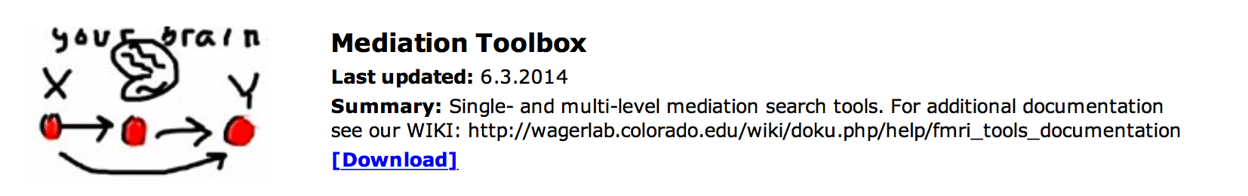
Single-level mediation effect parametric mapping in fMRI
Wagerlab.colorado.edu
Walkthrough for setup of sample data
Tor D. Wager
University of Colorado
January 2015
Download toolbox by clicking here
WIKI help page: Click here

Slide 2
Citing the mediation toolbox
The key papers describing the toolbox are below. It would be helpful to cite these papers when using the M3 toolbox. The manuscripts and supplementary information contain fairly complete descriptions of the model and statistical procedures used.
Wager, T. D., Davidson, M. L., Hughes, B. L., Lindquist, M. A., & Ochsner, K. N. (2008). Prefrontal-subcortical pathways mediating successful emotion regulation. Neuron, 59(6), 1037-1050. doi:10.1016/j.neuron.2008.09.006
Wager, T. D., Waugh, C. E., Lindquist, M., Noll, D. C., Fredrickson, B. L., & Taylor, S. F. (2009). Brain mediators of cardiovascular responses to social threat, Part I: Reciprocal dorsal and ventral sub-regions of the medial prefrontal cortex and heart-rate reactivity. NeuroImage, 47, 821-835.
For a sample of other papers, please see slides at the end of this presentation.
This toolbox was developed under a grant from the U.S. National Science Foundation (NSF). Please cite Grant NSF 0631637. “Multilevel mediation techniques for fMRI.”
Thank you!

Slide 3
Before you start: Download and install
Before you start, the CANlab_Core_Tools must be added to your path with subfolders. Otherwise, you will get errors. They can be found on Github, here:
https://github.com/canlab
Download or "clone" (add to your Github Destkop) these two toolboxes and add each to your Matlab path with subfolders:
https://github.com/canlab/CanlabCore
https://github.com/canlab/MediationToolbox

Slide 4
Sample dataset
A sample dataset is in the "Sample_datasets" folder in CANlab_Core_Tools.
Some others are in this repository as well:
https://github.com/canlab/CanlabCore
This example will use emotion regulation data in the "Sample_datasets" folder, in this subfolder:
"Wager_et_al_2008_Neuron_EmotionReg”
The dataset is a series of contrast images from N = 30 participants. Each image is a contrast image for [reappraise neg vs. look neg] for one participant.
These data were published in:
Wager, T. D., Davidson, M. L., Hughes, B. L., Lindquist, M. A., Ochsner, K. N.. (2008). Prefrontal-subcortical pathways mediating successful emotion regulation. Neuron, 59, 1037-50.

Slide 5
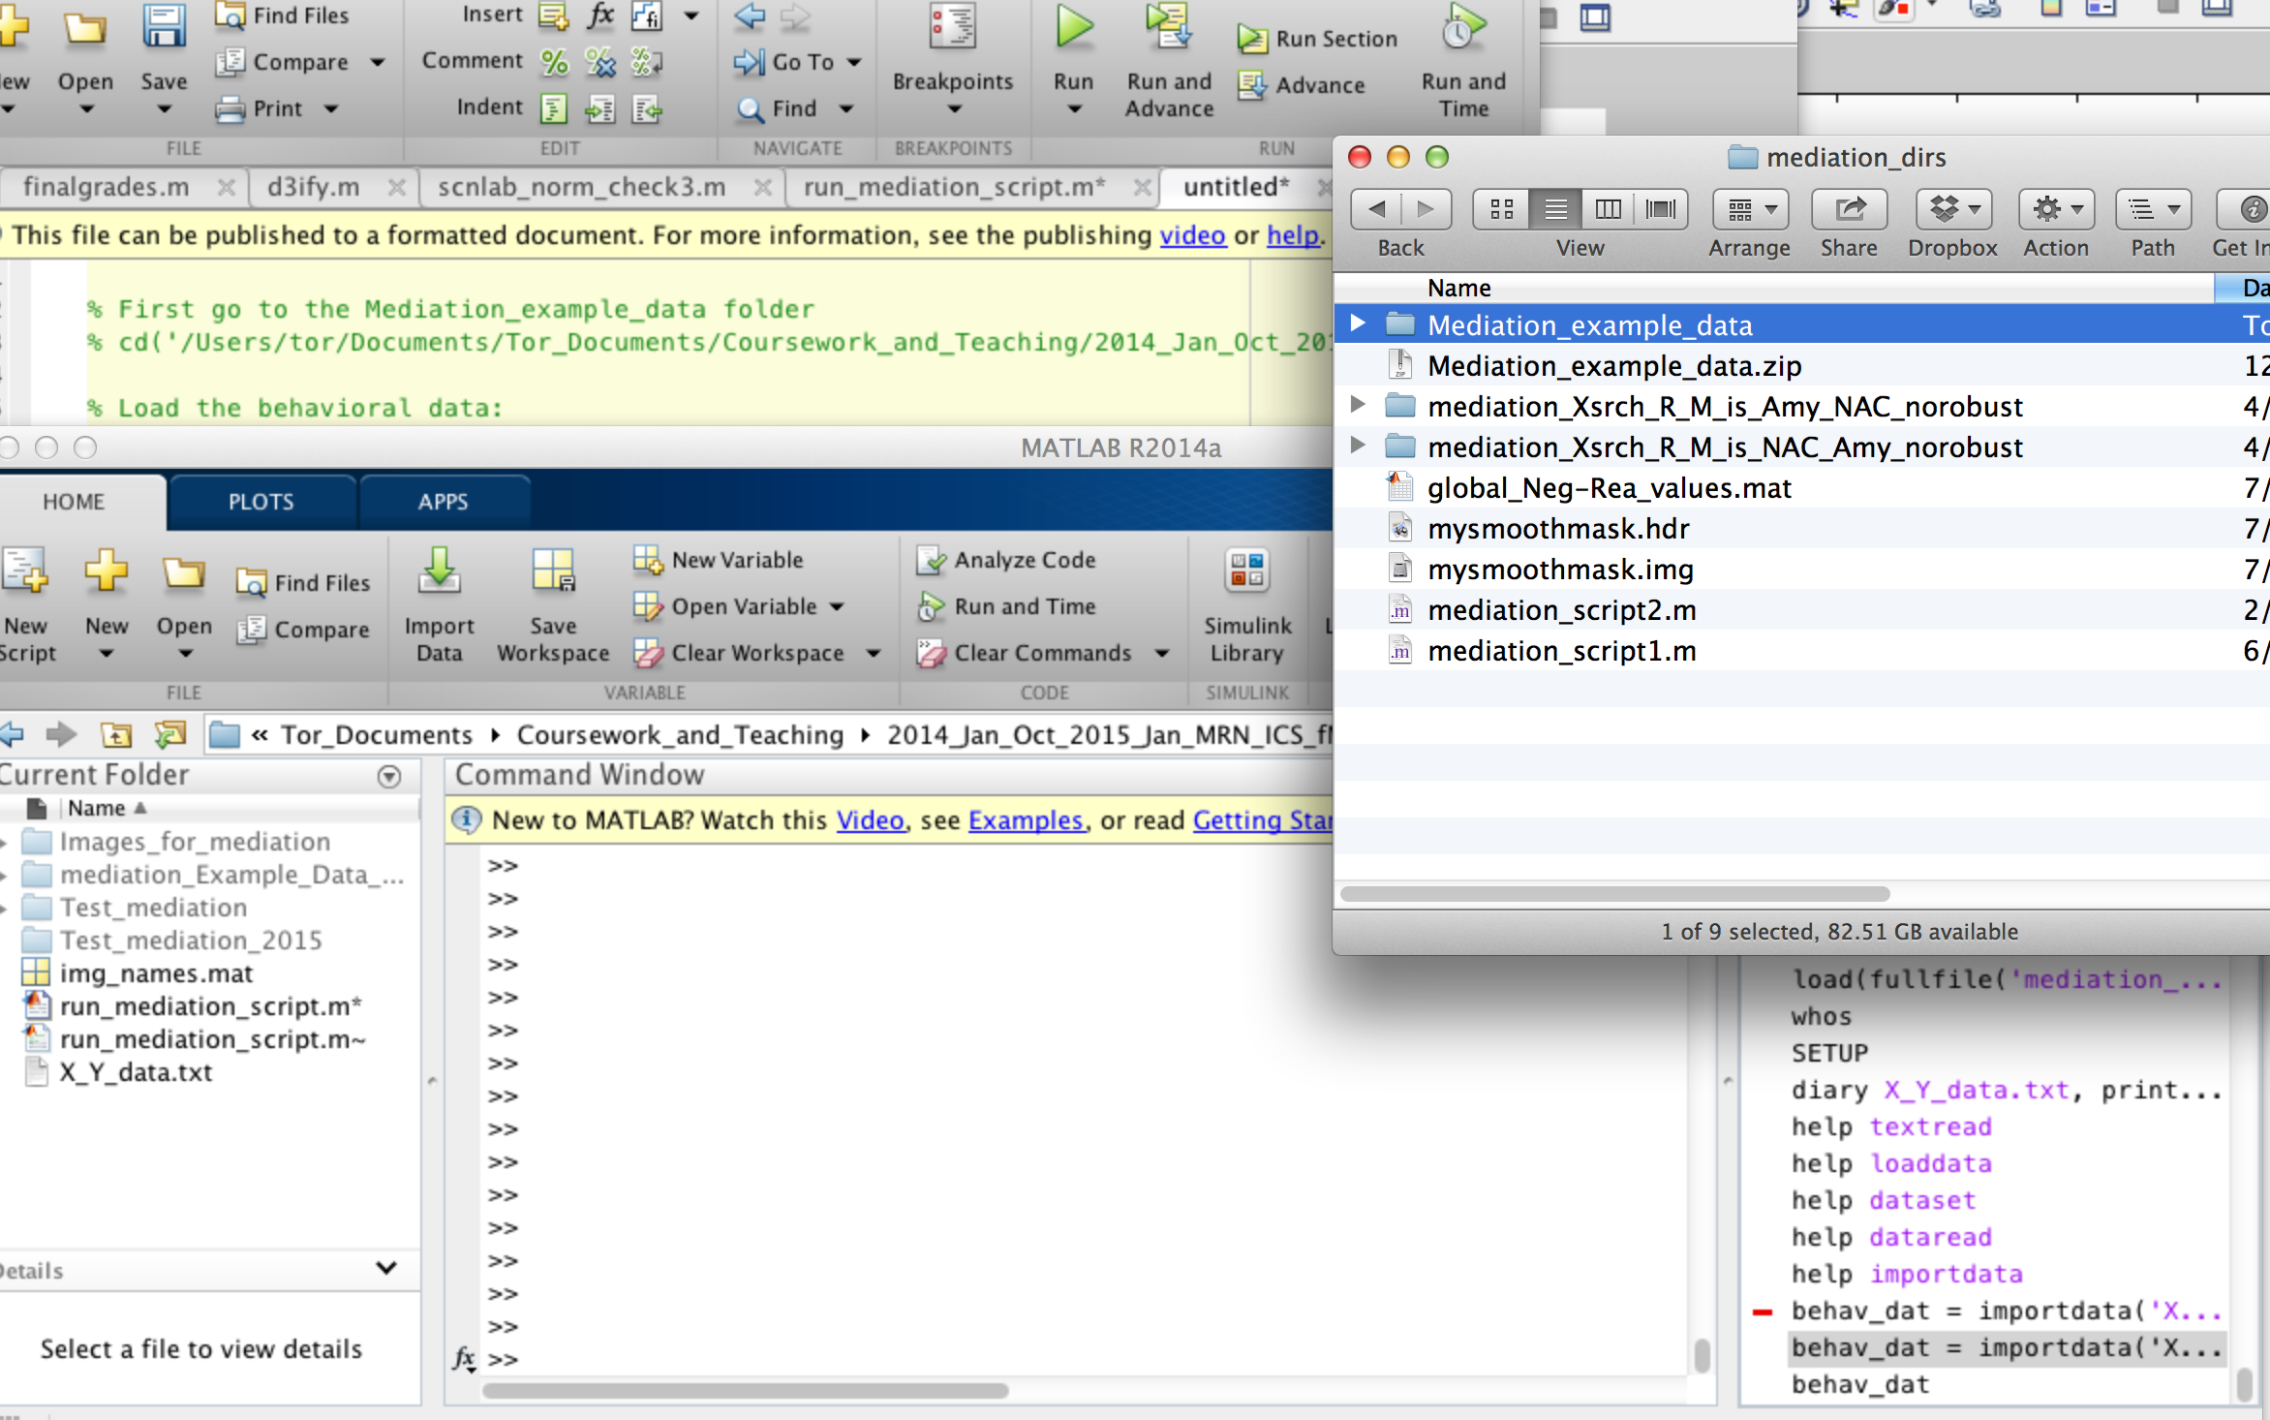
Step 1. Go to sample mediation directory
Drag and drop into command window

Slide 6
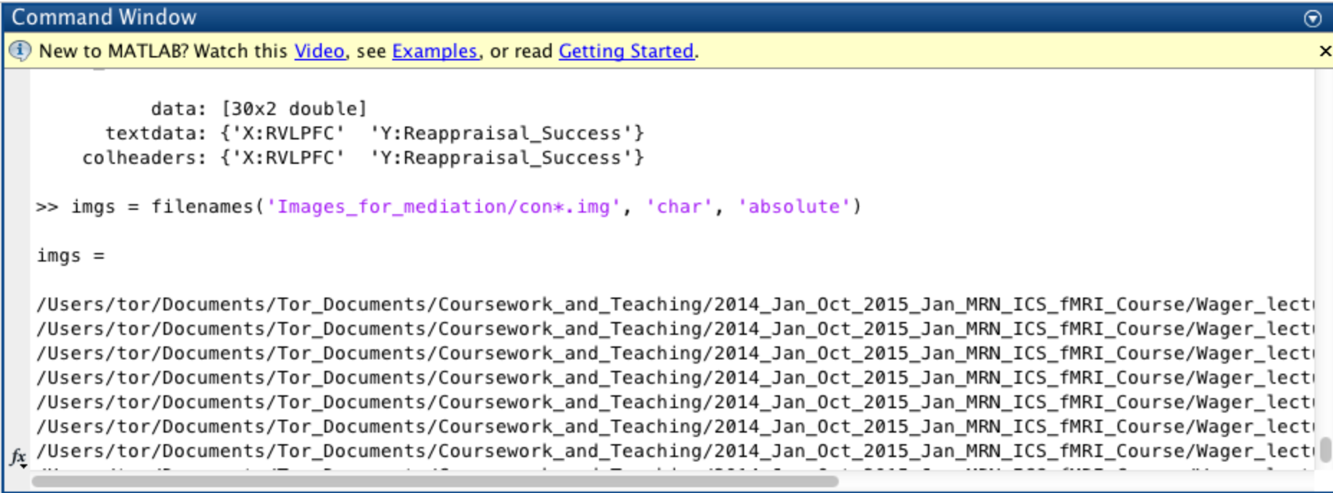
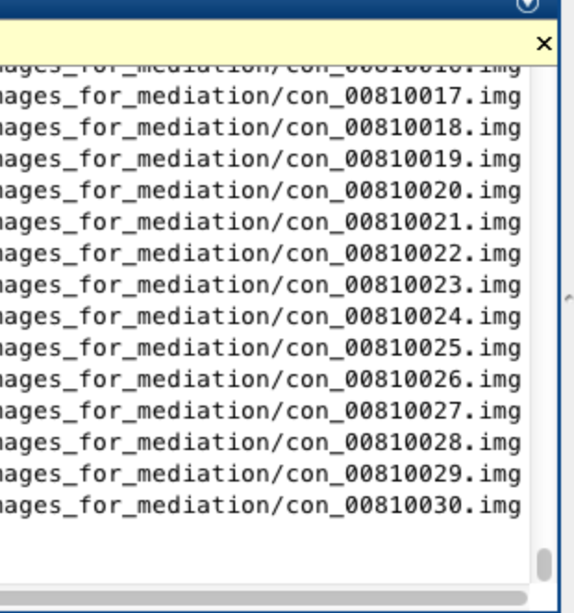
Step 2: List image names
Here I used ‘filenames’ command, available in CANlab core tools. May need other methods depending on operating system.
Character array of names are stored in ‘imgs’ variable.

Slide 7
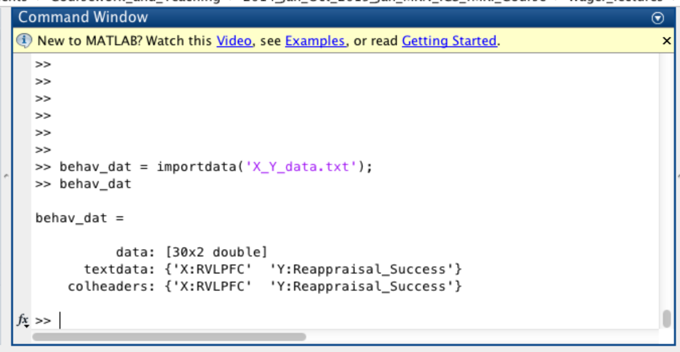
Step 3: Import behavioral data from text file
These are vectors of numbers, one per subject, in the same order as the image files we just loaded
They are saved in the file ‘X_Y_data.txt’ in the mediation test data folder

Slide 8
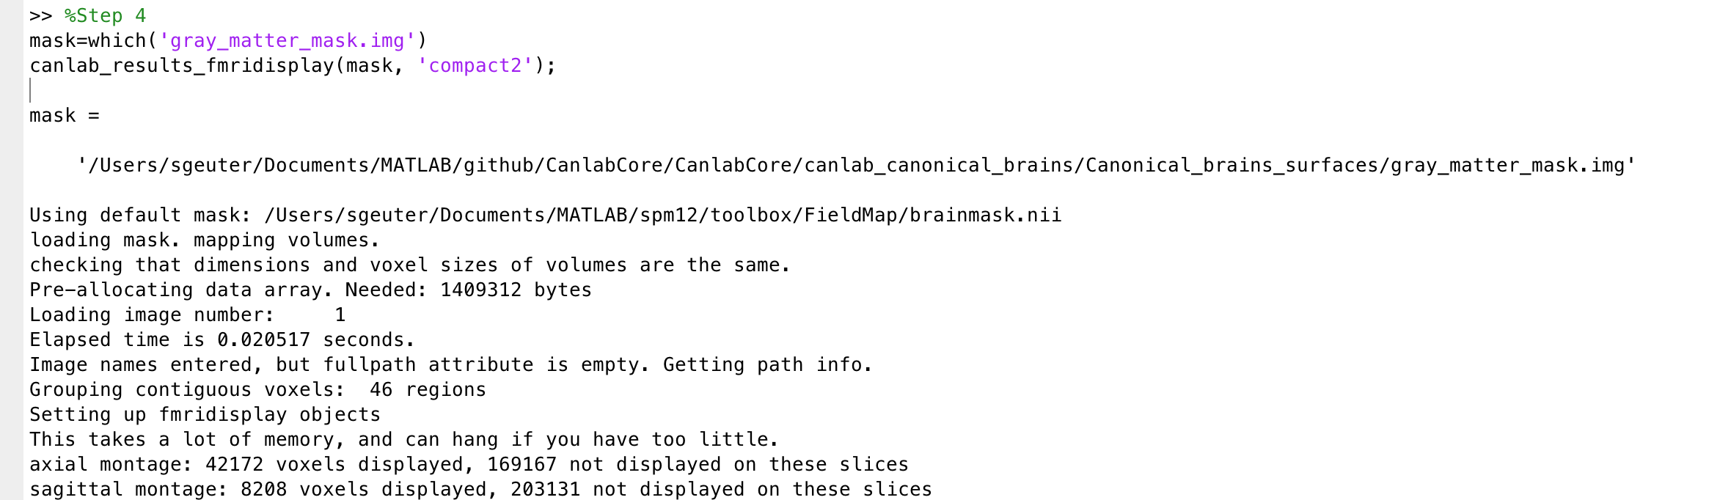
Step 4: Specify mask filename and visually check mask
We will load a canonical gray matter mask, and save the name in the variable ‘mask’
This specifies the voxels that will be analyzed in the mediation analysis
canlab_results_fmridisplay.m in CANlab core tools is used to visually display the mask. You can use other programs as well.

Slide 9
Step 5: Make and go to the results directory
Pre-calculated results are saved in this folder:
mediation_Example_Data_Wager2008_Msearch_R_XisRIFGstim_norobust

Slide 10
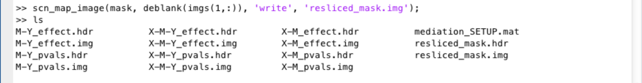
Step 6: Resample the mask
Resample the mask to the space of the functional images (may be required if spaces do not match)
I used ‘scn_map_image.m’ in CANlab core tools
Creates this resampled mask image

Slide 11
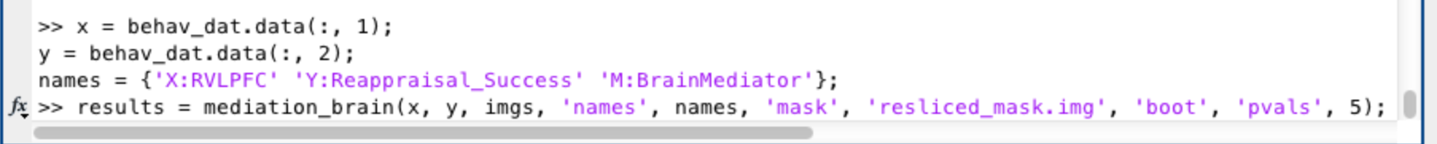
Step 7: Run the mediation
The code below defines x and y variables (VLPFC seed contrast values and Reappraisal Success values, respectively, in this dataset) and variable names
The last line runs the mediation with bootstrapped P-values
Here we are entering image names as the mediator, so we will test the mediation with brain data as the mediator (M) at each voxel.
It is also possible to enter imaging data as the X or Y variable.

Slide 12
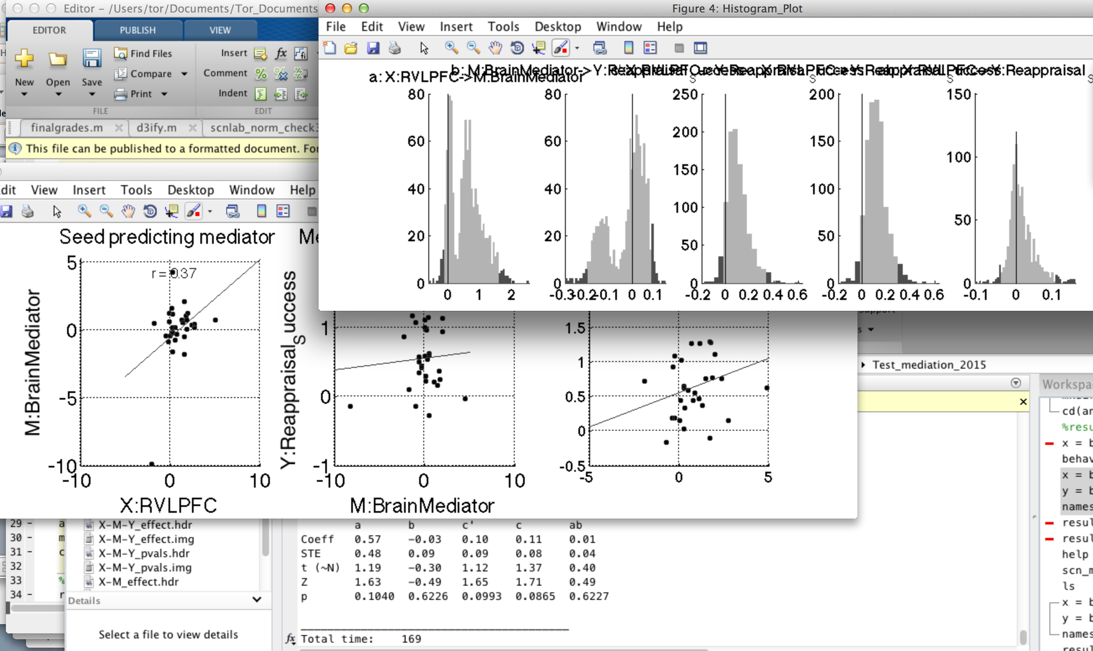
Step 8: Wait for mediation to finish
Scatterplots and bootstrapped histograms are shown for the first voxel in each slice.
The program will stop when all results over the brain have been run
Output is saved in the current (i.e., results) directory in the form of images and a mediation_SETUP.mat file with information about the input variables and options selected.

Slide 13
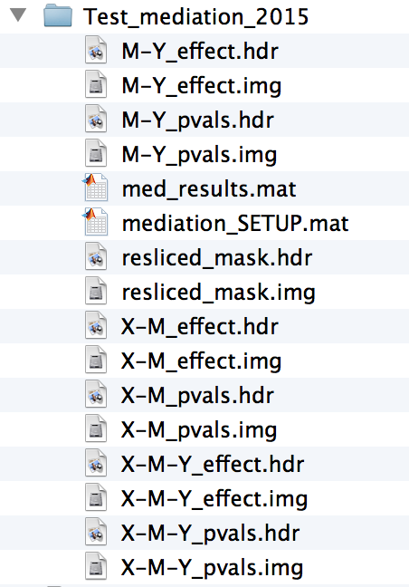
Step 9: Get results
There are many options for getting result maps, tables, extracted data from significant clusters, etc. There is also a batch script to generate and save sets of results montages, tables, etc.
The main functions are mediation_brain_results.m and mediation_brain_results_full_script.m
Images before results scripts are run:
Effect magnitude images for Path a (X-M), Path b (M-Y), and a*b mediation (X-M-Y)
P-value images for Path a (X-M), Path b (M-Y), and a*b mediation (X-M-Y)
Mediation_SETUP.mat : input options and values

Slide 14
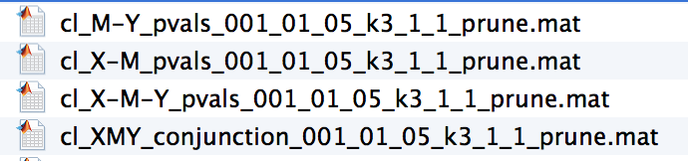
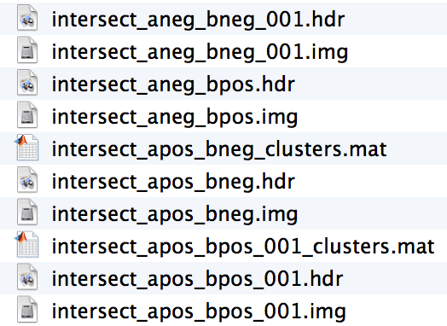
Step 9: Get results
There are many options for getting result maps, tables, extracted data from significant clusters, etc. There is also a batch script to generate and save sets of results montages, tables, etc.
The main functions are mediation_brain_results.m and mediation_brain_results_full_script.m
Images created when results scripts are run:
‘Clusters’ file with significant blobs, coordinates, etc.
Extracted data for averages for each region
Can plot/re-run mediation.m on ROI data (good for display; note circularity issues)
Conjunction images for significant path a and b effects
These can help with interpretation.
- For positively signed ‘path c’ effect, mediators should have either a pos and b pos or a neg and b neg (a*b is positive)
- For negatively signed mediators, a*b should be negative

Slide 15
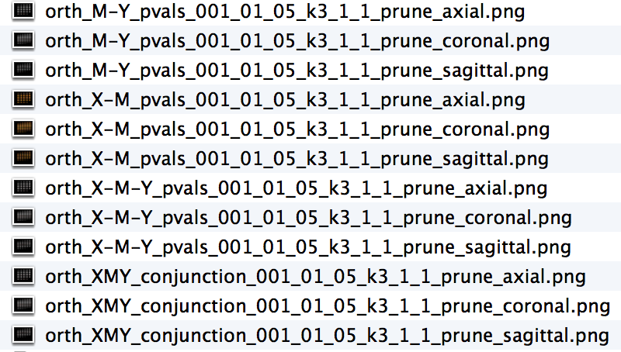

Step 9: Get results
There are many options for getting result maps, tables, extracted data from significant clusters, etc. There is also a batch script to generate and save sets of results montages, tables, etc.
The main functions are mediation_brain_results.m and mediation_brain_results_all_script.m
Images created when results scripts are run:
Images of montages of significant regions for each path
Tables of significant results for each path

Slide 16
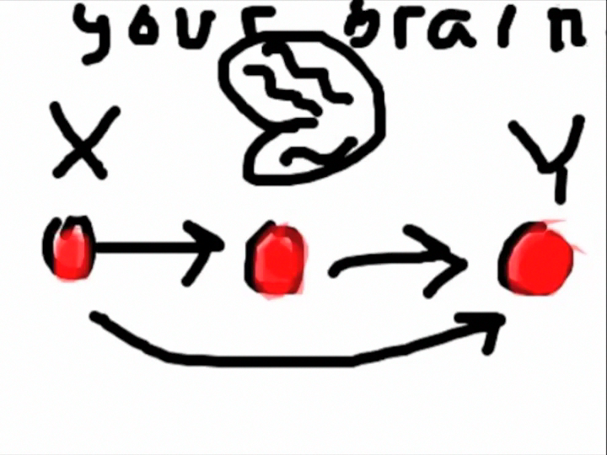
Step 9b: Batch results
The movie below shows you several major options

Slide 17
Here is a sample of papers using the M3 mediation toolbox. If you know of others we should include, please let us know!
Atlas, L. Y., Bolger, N., Lindquist, M. A., & Wager, T. D. (2010). Brain mediators of predictive cue effects on perceived pain. J Neurosci, 30(39), 12964-12977. doi:10.1523/JNEUROSCI.0057-10.2010
Atlas, L. Y., Lindquist, M. A., Bolger, N., & Wager, T. D. (2014). Brain mediators of the effects of noxious heat on pain. Pain, 155(8), 1632-1648. doi:10.1016/j.pain.2014.05.015
Buhle, J., & Wager, T. D. (2010). Performance-dependent inhibition of pain by an executive working memory task. Pain, 149(1), 19-26. doi:10.1016/j.pain.2009.10.027
Chen, C., Yang, C.-Y., & Cheng, Y. (2012). Sensorimotor resonance is an outcome but not a platform to anticipating harm to others. Social neuroscience, 7(6), 578-590.
Cremers, H. R., Veer, I. M., Spinhoven, P., Rombouts, S. A., Yarkoni, T., Wager, T. D., & Roelofs, K. (2015). Altered cortical-amygdala coupling in social anxiety disorder during the anticipation of giving a public speech. Psychol Med, 45(7), 1521-1529. doi:10.1017/S0033291714002657
Denny, B. T., Ochsner, K. N., Weber, J., & Wager, T. D. (2014). Anticipatory brain activity predicts the success or failure of subsequent emotion regulation. Social cognitive and affective neuroscience, 9(4), 403-411. doi:10.1093/scan/nss148
Fan, Y.-T., Chen, C., Chen, S.-C., Decety, J., & Cheng, Y. (2014). Empathic arousal and social understanding in individuals with autism: evidence from fMRI and ERP measurements. Social cognitive and affective neuroscience, 9(8), 1203-1213.
Johnston, N. E., Atlas, L. Y., & Wager, T. D. (2012). Opposing effects of expectancy and somatic focus on pain. PLoS One, 7(6), e38854. doi:10.1371/journal.pone.0038854
Kober, H., Barrett, L. F., Joseph, J., Bliss-Moreau, E., Lindquist, K., & Wager, T. D. (2008). Functional grouping and cortical-subcortical interactions in emotion: A meta-analysis of neuroimaging studies. NeuroImage, 42, 998-1031.
Kober, H., Mende-Siedlecki, P., Kross, E. F., Weber, J., Mischel, W., Hart, C. L., & Ochsner, K. N. (2010). Prefrontal–striatal pathway underlies cognitive regulation of craving. Proceedings of the National Academy of Sciences, 107(33), 14811-14816.
Krawitz, A., Fukunaga, R., & Brown, J. W. (2010). Anterior insula activity predicts the influence of positively framed messages on decision making. Cognitive, Affective, & Behavioral Neuroscience, 10(3), 392-405.
Lim, S.-L., Padmala, S., & Pessoa, L. (2009). Segregating the significant from the mundane on a moment-to-moment basis via direct and indirect amygdala contributions. Proceedings of the National Academy of Sciences, 106(39), 16841-16846.
López-Solà, M., Woo, C.-W., Pujol, J., Deus, J., Harrison, B. J., Monfort, J., & Wager, T. D. (2016). Towards a neurophysiological signature for fibromyalgia. Pain.
Schneider, S., Peters, J., Bromberg, U., Brassen, S., Miedl, S. F., Banaschewski, T., . . . Garavan, H. (2012). Risk taking and the adolescent reward system: a potential common link to substance abuse. American Journal of Psychiatry.
Vachon-Presseau, E., Roy, M., Woo, C.-W., Kunz, M., Martel, M.-O., Sullivan, M. J., . . . Rainville, P. (2016). Multiple faces of pain: Effects of chronic pain on the brain regulation of facial expression. Pain.
van Ast, V. A., Spicer, J., Smith, E. E., Schmer-Galunder, S., Liberzon, I., Abelson, J. L., & Wager, T. D. (2016). Brain Mechanisms of Social Threat Effects on Working Memory. Cerebral cortex, 26(2), 544-556. doi:10.1093/cercor/bhu206
Wager, T. D., Davidson, M. L., Hughes, B. L., Lindquist, M. A., & Ochsner, K. N. (2008). Prefrontal-subcortical pathways mediating successful emotion regulation. Neuron, 59(6), 1037-1050. doi:10.1016/j.neuron.2008.09.006
Wager, T. D., van Ast, V. A., Hughes, B. L., Davidson, M. L., Lindquist, M. A., & Ochsner, K. N. (2009). Brain mediators of cardiovascular responses to social threat, Part II: Prefrontal-subcortical pathways and relationship with anxiety. NeuroImage, 47, 836-851.
Wager, T. D., Waugh, C. E., Lindquist, M., Noll, D. C., Fredrickson, B. L., & Taylor, S. F. (2009). Brain mediators of cardiovascular responses to social threat, Part I: Reciprocal dorsal and ventral sub-regions of the medial prefrontal cortex and heart-rate reactivity. NeuroImage, 47, 821-835.
Woo, C. W., Roy, M., Buhle, J. T., & Wager, T. D. (2015). Distinct brain systems mediate the effects of nociceptive input and self-regulation on pain. PLoS biology, 13(1), e1002036. doi:10.1371/journal.pbio.1002036
Yamamoto, D. J., Woo, C. W., Wager, T. D., Regner, M. F., & Tanabe, J. (2015). Influence of dorsolateral prefrontal cortex and ventral striatum on risk avoidance in addiction: a mediation analysis. Drug Alcohol Depend, 149, 10-17. doi:10.1016/j.drugalcdep.2014.12.026

